Slide 1
Government by Design Techniques for Designing and Managing the Business of Government
Jim Amsden (jamsden@us.ibm.com)
Editable Text Editable Text Editable Text
Notes:
BIO: Jim Amsden is an IBM Senior Technical Staff Member and Solution Architect responsible for the Government Industry Vertical in the Rational Division. Jim works on a broad range of solutions incorporating IBM products for municipal strategic planning; solution analysis, design and construction; operational efficiency and monitoring; and business intelligence - tying these together into a comprehensive offering supporting IBM's Smarter Cities initiative. Jim has spent many years developing standards and products for modeling in order to understand and manage complex systems. He is a TOGAF Certified Enterprise Architect.
Good afternoon and thank you for the opportunity to talk to you today about the tools and techniques that can help you design your government. Let’s start with a quick look at some of the key public sector challenges.
Government organizations are facing extreme challenges to deliver more with fewer resources, to maintain or increase service levels with a smaller workforce and reduced budgets. Addressing these challenges requires a strategic approach to determining what businesses the government should be in and to what extent they should be in them based on citizens' needs and available revenue.
What governments need is a rational process for planning and budgeting, performance management, and operations that maximize outcomes from available revenue. This requires a means of capturing, assessing and communicating information about their current environment and then determining, evaluating and choosing actions that evolve their programs and services to achieve desired results while managing costs.
Government by design is the concept of applying strategic planning to government in a form that provides a comprehensive view of the entirety of the business you are in and the services your agency or organization provides.

Slide 2
No matter the variable forces at play, often the core issue is the lack of a cohesive and inclusive process
Careful and proper information management helps you:
Do the right things: through results-based budgeting and policy analysis
Do things right: through performance assessment and management aligned with policy initiatives
Manage change: for continuous refinement of delivered services through process optimization to deliver the results citizens want at a price they are willing to pay
Notes:
No matter what the challenges are, we can always strive to do the best with what we have. To do this, we need an effective approach to planning and budgeting that will deliver the results citizens need at a price they are willing to pay.
Policy planning and budgeting requires a process and supporting information to address three fundamental concerns. First you need determine what are the highest priority things you need to do in terms of the services you provide to address citizen needs. Second you need to determine the most efficient and cost effective way of delivering those services. And third you need to find ways to leverage citizen groups, community organizations and private sector businesses to collaboratively work together for transparent, effective and efficient government.
This Government By Design presentation explores some approaches for planning and budgeting and performance management that are supported by tools in order to explain the processes, capture and retain the required supporting information, and make the processes accessible and efficient enough that you can respond quickly to new or changing information. The goal is to provide methods, processes and tools that enable and foster continuous improvement rather than rewards and punishments as a means to facilitate government evolution to meet changing citizen needs. These tools and techniques are intended to address both the needs of "Steeres", those addressing the policy domain having needs for accountability, planning and budgeting, and those of the "Rowers", those addressing the functional domain having needs for to improve operations.
I’ll be covering a lot of concepts quickly and at a high level. Roy and I will be happy to follow-up with any additional information you might need.

Slide 3
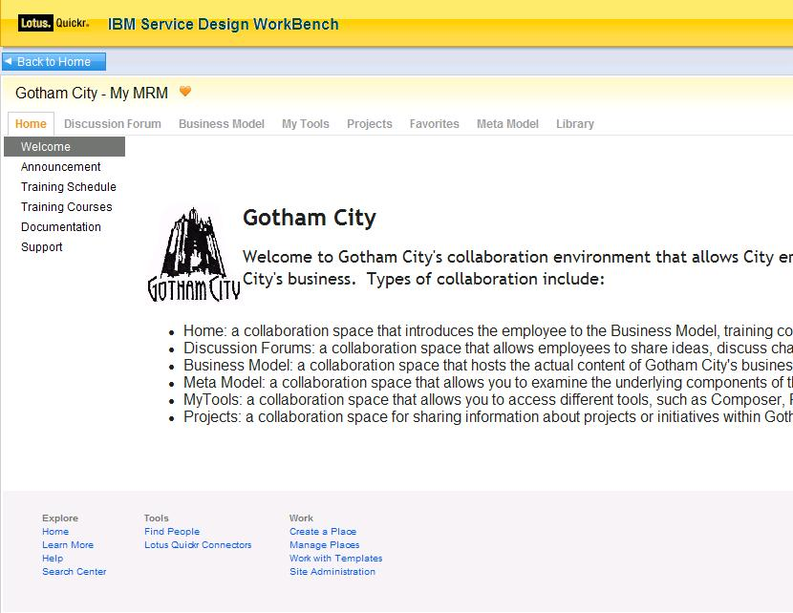
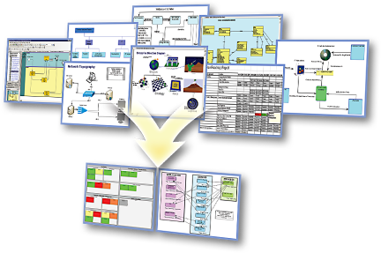
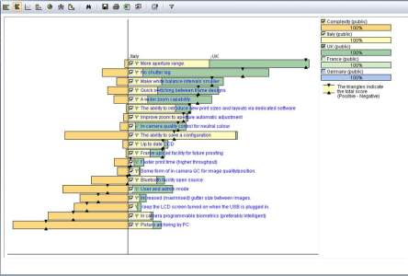
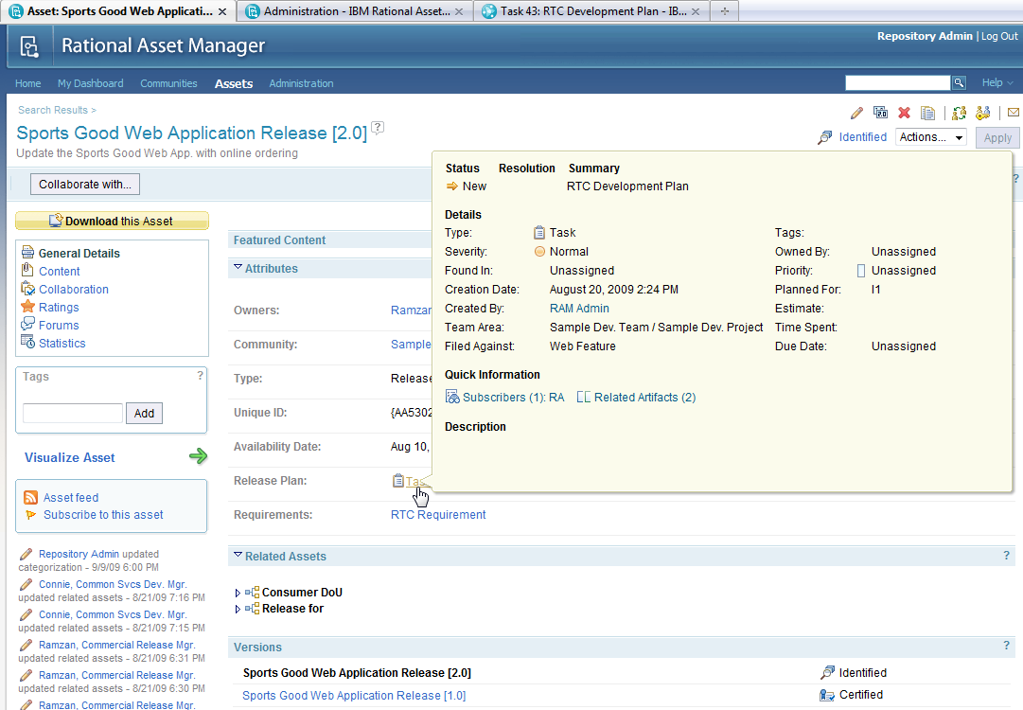
The Rational Service Design Workbench provides the tools needed to help address challenges and deliver results
Business User
Business Analyst
Planner
Lotus Connections,
SA/XT, SA Publisher
System Architect,
RAM, RPE, Cognos
Focal Point, Cognos
Collaborate – forums, wikis, news, defects, enhancement, etc.
Capture, validate and reason about model content
Review business component content published from SA
Optional: Review and edit Public Sector Model with SA/XT
Create & manage business components
Build relationships between components
Query business components
Compare business components in one municipality or across municipalities
Import/Export business component matrices
Elaborate on business components with documents, BPMN diagrams, UC diagrams
Compare and merge content from different analysts
Perform cost/benefit analysis
Weight user importance against factors such as cost, development times, and available resources
Build, buy, or outsource decision
Optimize program and asset operations/maintenance
Notes:
IBM Rational provides a number of tools that can help you address these challenges and deliver results. The offering involves the integration of a number of IBM products that support requirements definition and management, municipal business architecture, strategic planning, portfolio and strategy management, and collaboration, review and approval. The solution supports a large number of use cases to deliver value.
The stakeholders are organized into three broad categories. Business users use collaboration tools to communicate, validate and reason about the business models and budget information while doing less creation and editing of that information. Business analysts are responsible for creating and managing the business components and the relationships between them. They will use richer business modeling and reporting tools to create the work products that are consumed by the business users. Planners take the information from the business analysts, assess different opportunities and solutions for addressing citizens’ needs, and perform cost/benefit analysis to determine what projects and programs to fund, or what performance gaps to close.
Business User Artefacts:
Login/Registration
Home, News, Reference Material, Contacts, Help pages
Discussion Forum
MRM browse, municipal model browse/update
Change Requests page
Business Analysts
MRM access and municipal model access and update
Business Model Report
Program Profile Report
Service Profile Report
SIAM Diagram
Hierarchy Diagrams
Relationship Matrices
Stakeholder-specific Browsers
Planner
Project portfolio
Strategic alignment analysis
Risks, costs, time to value,
Payback Period
Project roadmapping

Slide 4
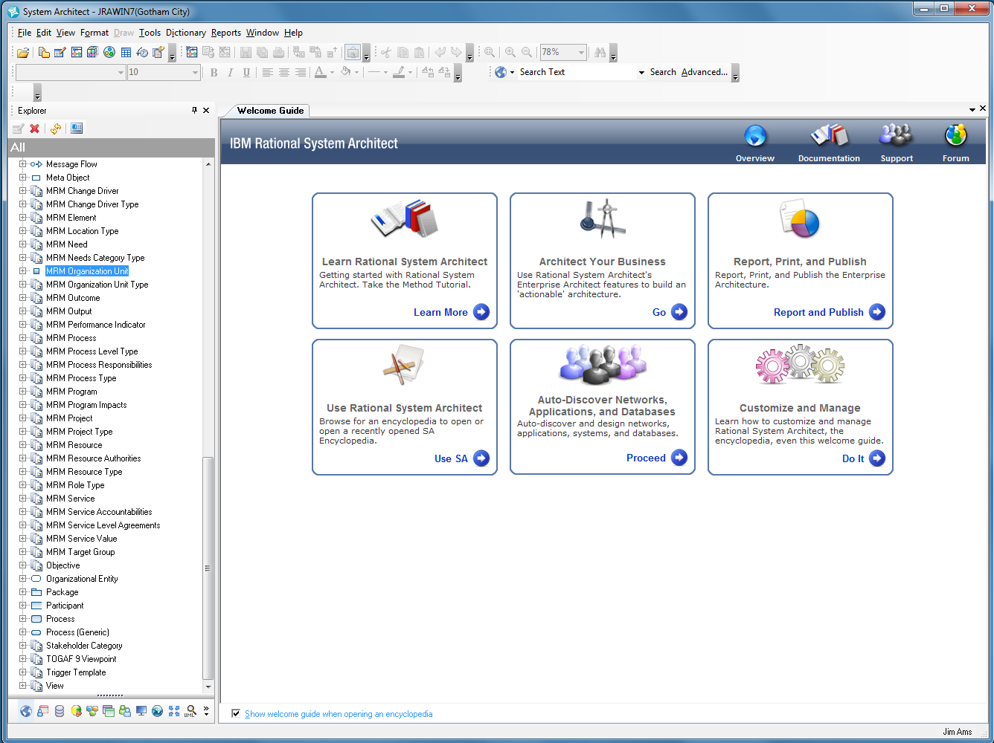
Notes:
So let’s take a close look at some of the tools these stakeholders will be using.
The business analysts tools provide a means of exploring and editing the model content. For example, the model Explorer shows the kinds of elements the analysts can manipulate including definitions, diagrams and matrices for editing relationships between elements. Guidebooks help business analysts who are less familiar with the tools be more productive. The guidebooks are navigated through hyper-links providing guidance on both the analysis methods, and the specific activities and tool capabilities that support those methods. Links in the guidebooks can directly invoke actions in the tools to provide step-by-step instructions for particular activities.

Slide 5
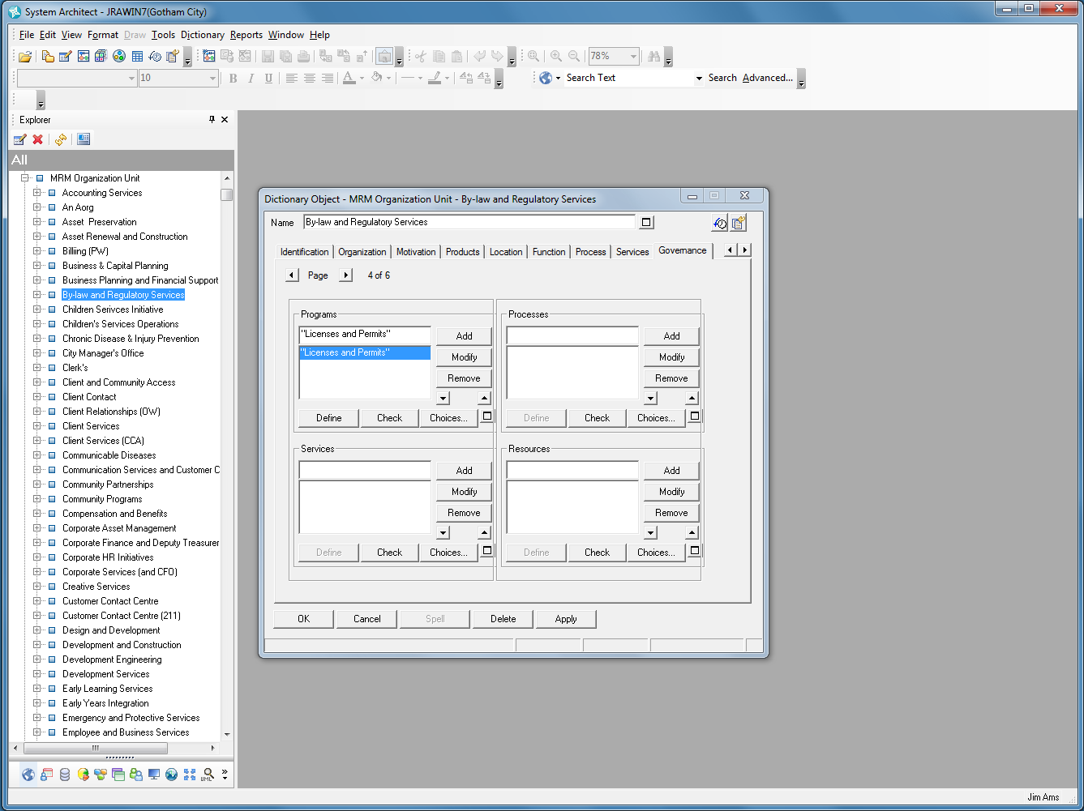
Notes:
In this view we have expanded the organization units in the model Explorer view, and selected the By-law and Regulatory Services organization unit and displayed its detailed properties. The properties are organized into tabs that describe the different kinds of information that can be collected. The current page show the programs, processes, services and resources the organization is accountable for. For example, the by-law and Regulatory Services organization unit is accountable for the selected Licenses and Permits program. We could press the Define button to navigate directly to the details of that program in order to see what outcomes it delivers and what services administers. The tool provides many facilities for navigating, searching, reporting on and analyzing information in the municipal business model through a number of different views.

Slide 6
MRM can be used in a number of ways to facilitate results-based government
Strategic Planning - Determining results you wish to achieve and the strategies for achieving them
Public Sector Business Architecture – Designing the programs and services that deliver the outcomes that address citizens’ needs
Budgeting for Outcomes - Determining the services and service levels that provide the outcomes citizens want at a price they are willing to pay
Performance Management - Assessments of performance indicator actual vs. target values to drive operational improvements and inform future strategic planning activities to close the right performance gaps
Identify opportunities to exploit Information Systems solutions – Define the associated applications, data sources and platform technical architectures in support of the efficient, cost effective realization of public services – delivering more with less through IT exploitation
Notes:
Now that you’ve briefly seen the tools and the information they capture, lets take a look at some examples of things you might do with the tools.
You can use the models to capture and document the things that are motivating change in your jurisdiction, the results you wish to achieve in response to those influencers, and the strategies for achieving those results. Then you can evolve your municipal business architecture by designing the programs and services that deliver the outcomes that achieve the desired results and address your citizens’ needs. Unfortunately it will often be the case that you will have greater demand for services than can be supported by available revenue. Budgeting for outcomes is a Government Financial Officers Association recommended practice for allocating budgets to results delivered by programs and services that address the highest priority needs within available budgets. You can’t do everything, but you can always do the best you can with what you’ve got.
Once plans are in place and services are operational, you can use performance management to assess actual performance against targets to drive operational improvements and inform future strategic planning activities to close the right performance gaps. Performance management not only involves assessment against performance criteria, but also involves prioritization against citizens’ needs to determine which performance gaps to invest in closing. This is similar to the processes you use in budgeting for outcomes to determine what programs and services to fund, but is focused on operations management, not strategic planning.
Information technology is becoming more strategic in the public sector as you provide more information services for citizens and rely on IT to deliver other services. You can integrate your municipal business architecture with your information systems architecture to help identify opportunities to exploit IT for more efficient, cost effective, or smarter realization of public services – delivering more with less through IT exploitation. These models can also help you identify opportunities for IT application consolidation, or situations where you could collaborate with other jurisdictions to provide services through cost sharing.
We’ll look at how the tools support these activities in the following charts.
Some public sector business services may be informational in nature and can be completely automated in IT applications
Some processes contributing to the implementation of a business service may be automated with a BPM solution
Some activities in a business process, or resources used by a process may be candidates for IT automation

Slide 7
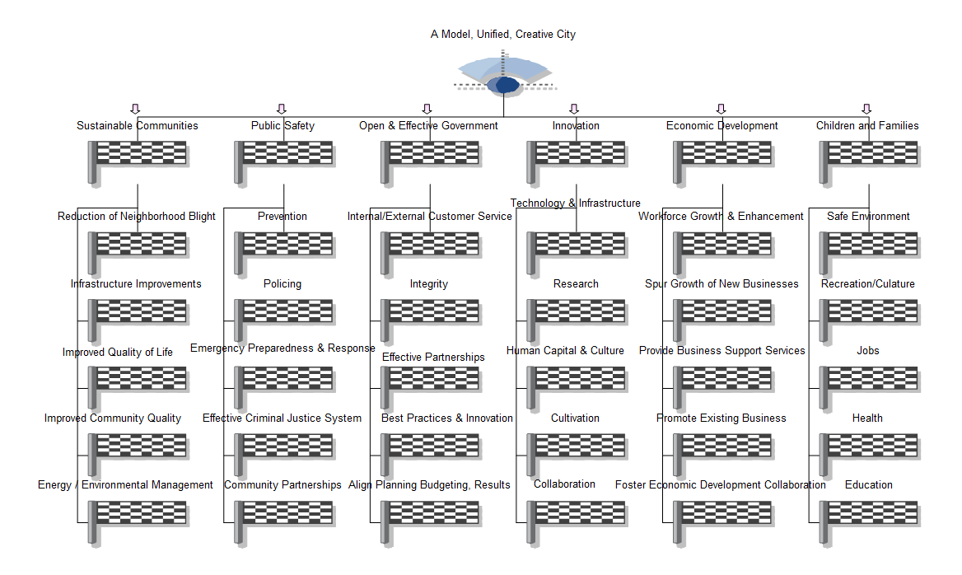
Organizing city goals into specific results areas allows you to connect services to goals and outcomes
Notes:
For example, this chart shows the vision of a model, unified, creative city that is amplified by goals for sustainable communities, public safety and so on. Each of these goals is further amplified by sub-goals that can communicate in one page what your city is intending to focus on achieving for your citizens.
Other diagrams can show strategies, tactics, business policies and rules, and can show how these are connected to the realizing programs and services that actually deliver the required outcomes.

Slide 8
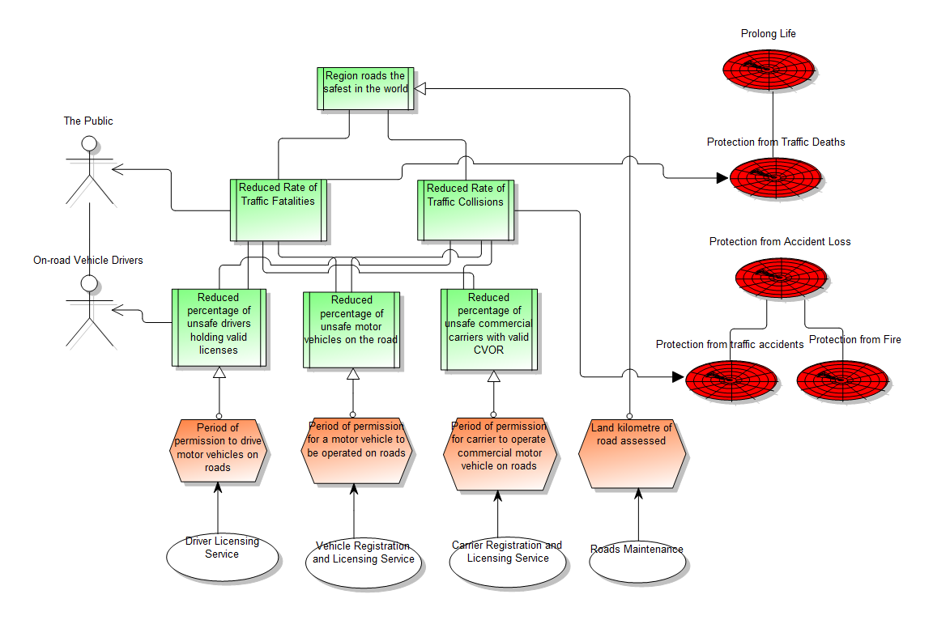
A Program Logic Model show the outcomes required to address target group needs and the services that deliver those outcomes
PROLONG
LIFE
Outcomes
THE PUBLIC
PROTECTION FROM DEATH
Needs
Target Group
ON ROAD DRIVERS
PROTECTION FROM LOSS
PROTECTION FROM TRAFFIC ACCIDENTS
PROTECTION FROM FIRE
Required Services
Drivers
License
Vehicle Registration
Carrier Registration and Licensing
Road
Maintenance
Notes:
The tools also provide a number of diagrams that help analyze and communicate information about the business of government.
The program logic model show the hierarchy of citizen needs in the area of prolonged life and protection from loss. In the center are the strategic, indirect, and direct outcomes that are required to address those needs. Outcomes are a change in level of need experienced by some target group in the community. On the bottom are the outputs and services that are required to deliver those outcomes. The administering programs can also be shown.
From the PLM diagram, you can easily see what needs are being addressed, what outcomes are required to address those needs, who experiences those outcomes, and what services are required to deliver them. This provides a way of reasoning about services and service levels that define the businesses a city is in, and how those businesses are relevant to its citizens.

Slide 9
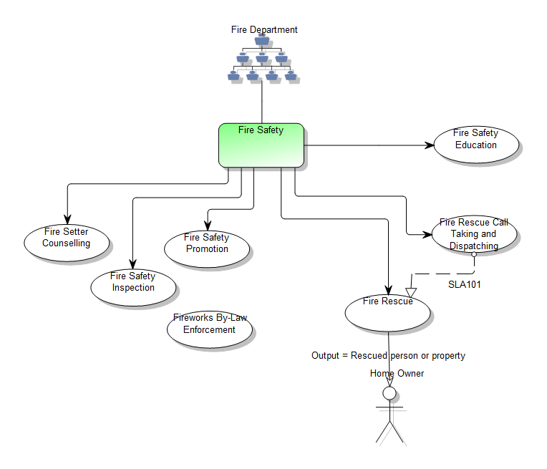
Connecting goals to outcomes requires showing the accountability from government organizations to citizen target groups
Service Integration and Accountability Model
Notes:
Another diagram that is useful is the Service Integration and Accountability Model or SIAM diagram. Accountability for delivering outcomes is fundamental to government operations. The SIAM diagram shows the relationship between organization units and target groups in the community by describing the programs they are accountable for, the services administered by those programs, the service-level agreements between services, the service outputs, and what target groups that are impacted by those outputs.
A SIAM diagram provides a simple visualization that connects the organization units of the government to organizations of its citizens, bridged by the programs and services that are provided by the government and consumed by its citizens. From this diagram it is easy to see who is accountable for delivering what to whom, and how. You can easily see organizations that are accountable for too much or too little, motivating reorganization activities. You can also see what target groups in the community are under or over served as input into change initiatives.

Slide 10
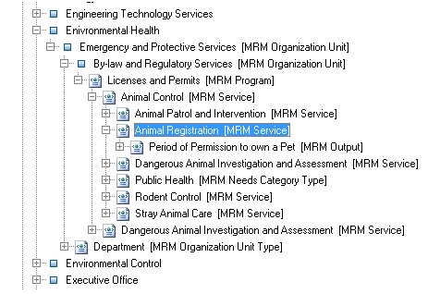
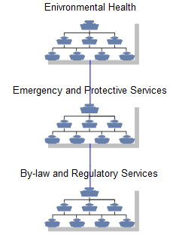
Consider the problem of animal control in Gotham City
We start by exploring accountable organization units
This diagram shows the organization unit hierarchy that is in the problem scope
By-law and Regulatory Services is accountable for the Licenses and Permits program
This program delivers public health outcomes
Notes:
Let’s explore an organization in more detail. We’ll consider the problem of animal control in Gotham City. The Explorer view and Animal Control MRM Hierarchy diagram show that the Environmental Health organization has a number of sub-organizations including Emergency and Protective Services which in turn has sub-organization unit By-lay and Regulatory Services. This organization unit is accountable for the Licenses and Permits program which among other things administers the Animal Control service. You can see from the Explorer view that Animal Registration is a sub-service of Animal Control.

Slide 11
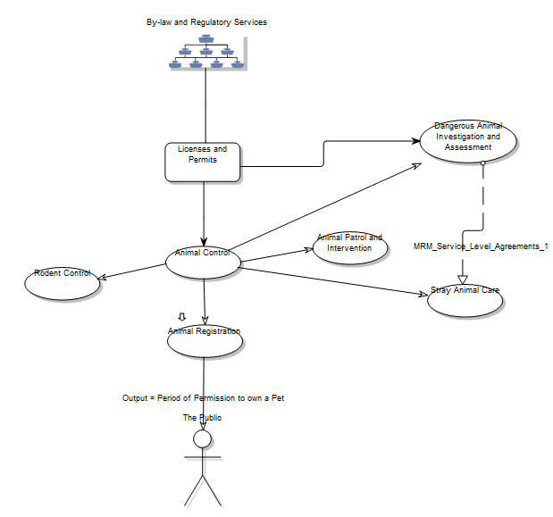
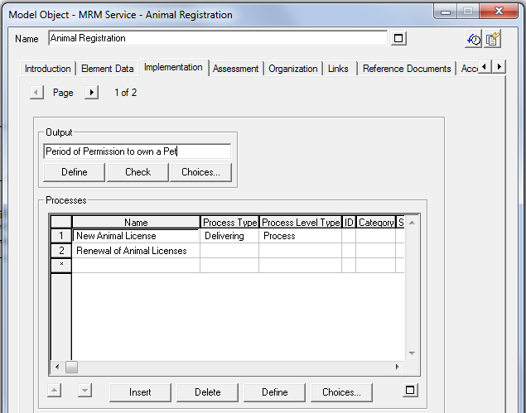
A SIAM diagram shows policies for what the organization units are accountable for and to whom
The Animal Registration service has a child diagram that is a BPMN processes for the implementation of that service (chart 35)
Notes:
The Animal Control MRM SIAM diagram helps us understand the details of the Animal Registration service.
The “By-law and Regulatory Services” organization unit is accountable for the “Licenses and Permits” program, which administers the “Animal Control” Service. This service has (among others) “Animal Registration” as a sub-service with delivers a “Period of Permission to own a Pet” to the “Public” target group
You can open the details on the Animal Registration service right from the diagram. You can see that the Animal Registration service is implemented by two processes. Notice the arrow decoration on the Animal Registration service. This indicate the service has a child diagram that can be used to show how the service is implemented.

Slide 12
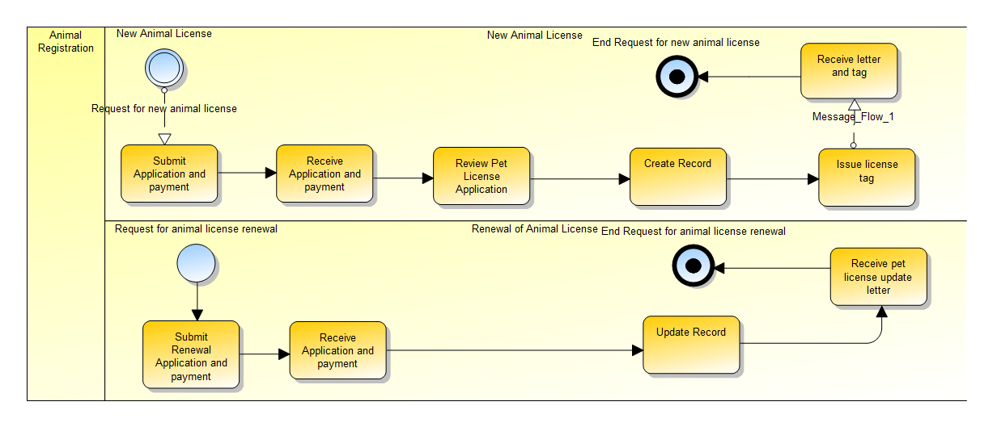
Implementation of a service, possibly involving multiple processes
The Animal Registration service is implemented using two processes
Pools represent services while lanes can be used to depict the different processes that are involved in implementing the service
Message exchanged between services represented by pools can describe the details of the interactions between services described by their service level agreements.
Notes:
The Animal Registration business process diagram models the implementation of the Animal Registration service, and is a child diagram of the Animal Registration service on the Animal Control SIAM diagram.
The service is implemented using two process, one for establishing new animal licenses, and another for license renewal. The pools in this diagram represents the Animal Registration service while lanes are used to depict the different processes that are involved in implementing the service. Messages exchanged between services represented by pools can describe the details of the interactions between services described by their service level agreements.

Slide 13
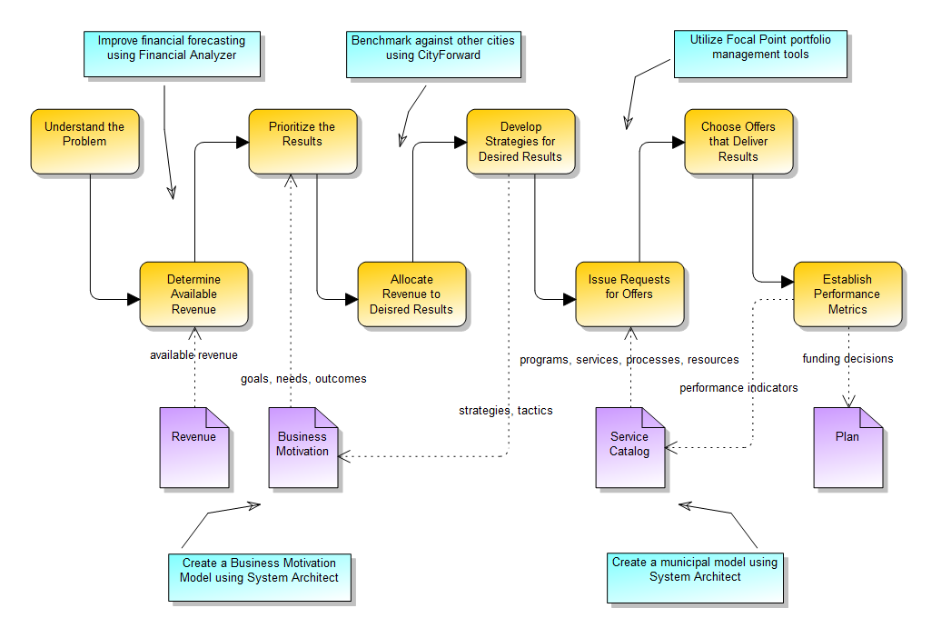
Planning requires a process that delivers the best results from available revenue
Budgeting For Outcomes
Notes:
Next we’ll take a brief look at planning and budgeting. Budgeting for Outcomes is one possible approach that was pioneered by Governor Gary Locke of Washington at a time when his state faced a $2.5 billion shortfall in its budget.
Quoting from Governor Locke: “The usual, political way to handle a projected deficit is to take last year's budget and cut. It is like taking last year's family car and reducing its weight with a blowtorch and shears. But cutting $2 billion from this vehicle does not make it a compact; it makes it a wreck. What is wanted is a budget designed from the ground up.”
The process evolved from Zero-based budget concepts and is described in a book by David Osborne and Peter Hutchinson called "The Price of Government: Getting the results we need in an age of permanent fiscal crisis". BFO is supported by consulting organizations such as Public Strategies Group and is a recommendation of the Government Finance Officers Association.
Any planning process can be challenged by uncertain, inaccurate, or missing information, and poor line-of-sight between city goals, supporting service offers, performance indicators and available revenue. Tools help make the process more efficient so that you can effectively respond to new and changing information. The process can also benefit from supporting information and tools for more efficient execution in order to ensure expected outcome: maximize outcomes for available revenue.
Tools can help in a number of ways:
Improved financial forecasting supporting Monte-Carlo simulation can provide more accurate and timely revenue estimates, and help deal with uncertain information.
Benchmarking against other cities can enable you to leverage their innovation and successes
Creating a Business Motivation Model to helps capture business strategy and policy information, and to enable the connection of motivational elements with the service catalog so you can connect services with the results they are intended to deliver.
Creating a municipal model provides a common language for describing and relating the large number of services provided by a city, and provides a service catalog that forms the basis for budget offers that can be connected to city goals, outcomes and citizen needs.
Using existing industry model assets such as the Municipal Information Systems Association’s Municipal Reference Model can help give you a head start on developing your services catalog, and in providing guidelines and best practices for addressing citizens’ needs that you can use for strategic planning. MISA, a Canadian Government organization, developed the MRM over 20 years of municipal and provincial practice and by harvesting best practices programs and services that have been proven to work.
Utilizing portfolio management tools helps to prioritize citizen needs as well as city goals that along with costs, risks, time to value and performance indicators so they can be used to objectively assess service offers and establish defensible, quantified rankings, and to enable what-if scenarios for exploring alternative rankings.
In subsequent webinars, we will go into the details of this budgeting process, showing how the activities and work products are supported by tools to get the most out of your planning activities.
13

Slide 14
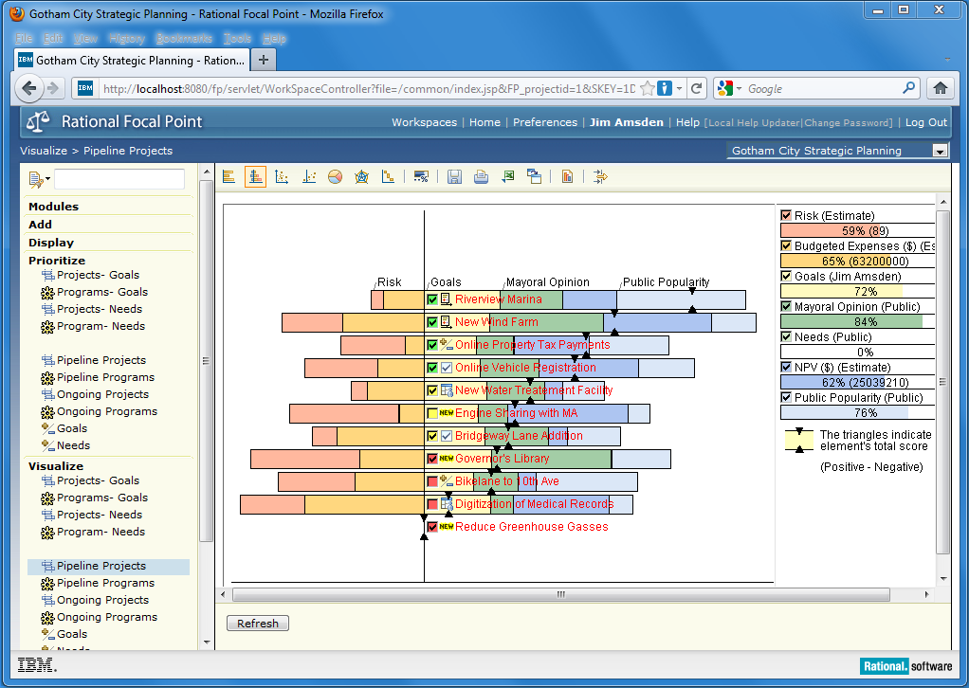
Do what-if scenarios to determine the impact of choices
What programs are we proposing to change and why?
Which projects should we invest in to maximize outcomes while minimizing costs?
Is our project portfolio aligned with our goals?
Are we incurring acceptable levels of risk?
What are the potential effects of various choices we might make?
Notes:
Once results have been established and prioritized, and service offers to deliver those results have been submitted, you have to make the hard budgeting decisions.
Choosing the offerings that deliver results involves determining which programs to invest in based on business goals, community needs prioritization, risk management, cost, and value. This approach to strategic planning provides emphasis on outcomes required to address needs instead of what to cut or what activities to optimize. Value becomes more relative, based on community need prioritization. Citizens can focus on what they’re getting for their tax dollars instead of what’s getting cut.
In this example the elements in the graph are pipeline programs that have completed business cases and are now ready for assessment. Business case and outcome data has been incorporated into the ‘Budgeted Expenses’ and ‘NPV’ criteria located in the upper right corner. Subjective criteria such as public popularity, can also be assessed using a pair wise comparison. Using the scoring from each criterion planners can make a decision about which potential projects and programs are the best candidates for launch based on current budget constraints. Then they can use a Gantt chart to schedule projects based on dependencies and resource availability.

Slide 15
Planning and Performance Management – Analysis / Recommendations
Performance Management can be enriched following agreement on reporting focus
Strategy Development & Tracking
Track progress against city’s mission & strategy
Operations Management
Identify & solve operational issues
Current NOLA Focus
Low
Performance
Management
Medium
Public Reporting & Transparency
Provide public with information on government operations
Management Accountability
Hold managers accountable for performance
Medium
Low
Priority Enhancements
Develop ‘State of the City’ Scorecard or Mayoral Dashboard
Automate existing reports while improving KPIs
Followed by:
Deeper operational performance reporting in select areas
Evolution of BlightStat to increase strategic focus
Adoption of new STAT programs for multi-agency, cross-sector issues
Extended public information sharing on neighborhood outcomes
Notes:
Performance management involves a number of related activities. Operations management consists of monitoring and assessing operational processes and activities against performance targets established during planning activities. These performance targets establish the intended services levels and are part of the municipal business model. Closing performance gaps involves understanding the accountable organization units and giving them the tools required to access performance against desired outcomes and prioritize what gaps to focus on closing. Reporting tools and access to accurate, timely data can make it easier to develop the reports and presentations needed to communicate performance to citizens and help determine acceptable actions for closing gaps, or changing targets during STAT meetings. Performance assessments can also be fed into the next round of strategic planning and budgeting as they may inform desirable or achievable service levels based on common practice or resource limitations.
Performance management tools can help you model performance indicators for your service catalog; assessing programs, services, processes and resources. You can align performance indicator targets with service levels derived from the purpose of the service, the outcome it contributes to and the needs it addresses, not just the processes used to implement the service.
It is important to distinguish what is being done, a policy decision from how it is being done, and operations management concerns. You can address these “steering” from “rowing” functions through separate performance assessments of programs and outcomes, services and service value, process efficiency, and resource usability to optimize what is being done as well as how well it is being done. Performance assessments can be performed incrementally using portfolio management tools with automatically generated dashboards, views and reports to provide the information you need to justify and drive action. This helps focus performance assessments against outcomes and needs, not just target values.

Slide 16
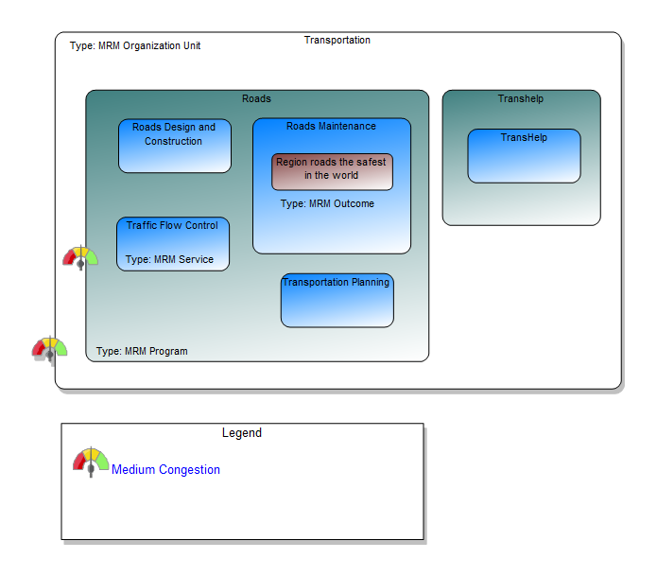
Use heat maps to visualize performance gaps and problem areas
Notes:
Additional diagrams can help communicate performance assessments. For example, Program Service and Accountability Model diagrams (PSAM) provide summaries of the programs and services that an organization unit is accountable for. Tools provide a means of creating “heat-maps” that depict assessments of performance indicators right on the PSAM diagram. We can see in this diagram an assessment of medium road congestion against the Transportation department, and the Roads program.

Slide 17
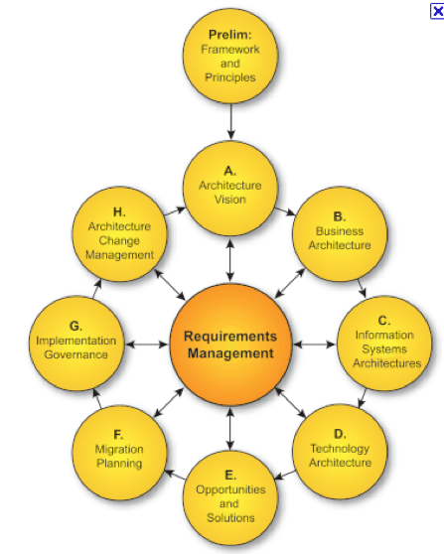
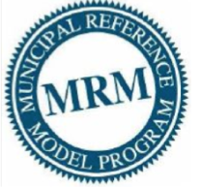
Connecting Business and IT: Use the TOGAF ADM as a method for creating and evolving your enterprise architecture to meet business needs
Extends
Notes:
Information Technology is becoming more strategic to the public sector every day. In order to respond to this opportunity, you need to be able to connect your business and IT components to ensure you are making the best use of your existing IT assets, and investing in IT for the future in a manner that is consistent with your business strategy.
The Open Group has established a standard Enterprise Architecture Development method, the TOGAF ADM. The ADM has a simple language for describing the elements of an enterprise architecture, and determining how the architecture should evolve to meet business needs. This language and its associated work products is intended to be extended for particular domains and to address the unique needs of any given organization. The MISA MRM has been implemented as an extension to the TOGAF business architecture to provide a language and method applicable to the public sector. This allows you to integrate your business architecture with your IT architecture to align IT against your business objectives. The TOGAF ADM provides a standard way of capturing and analyzing your complete enterprise architecture, integrated with your budgeting and performance management processes to help you deliver service excellence to your citizens.

Slide 18
The Service Delivery Workbench and related SaaS offerings can be delivered in the Cloud
Planning and Budgeting for Smarter Government Powered by CloudOne
IBM Rational System Architect – Core SDW capabilities
IBM Rational System Architect Publisher Add – to publish models to the web
IBM Rational System Architect XT - for business analyst Web Access
IBM Rational Publishing Engine – for document generation
Rational Focal Point – for prioritization, planning and portfolio management
Lotus Connections (or Lotus Quickr) – for collaboration on planning and other activities within and across government organizational boundaries
MISA MRM VPC – For the purpose of managing and governing the MRM by the MRM Working Group as directed by the MRM Steering Committee
Hosting Services:
Standard 2-5 Product offering
25G storage included
Standard BW included
Notes:
The complete Service Delivery Workbench, the MRM Authoritative Reference Model, the sample model for Gotham City and other supporting tools for document generation, reporting and portfolio and strategy management are all available in a SaaS offering at CloudOne. This allows you to get up and running in a matter of hours at a cost that is consistent with your needs. You can spend more time on what really matters to you: analyzing how you are going to address your citizens’ needs with available revenue, instead of how to install and configure tools. There are flexible product configuration and pricing strategies to meet your needs and budgets.
Thank you for this opportunity to summarize some of the IBM and Rational offerings that we hope can help you become a smarter city.

